Slide 1


Empowering Health, Transforming Lives
Salama AI
Empowering Health, Transforming Lives
SalamaAI
Notes:
Introduction:
Your name What your are presenting on: Salama AI
The project that’s trying to solve the 3rd SDG Goal
Targeting Indicator 3.4.1 AND 3.4.2

Slide 2
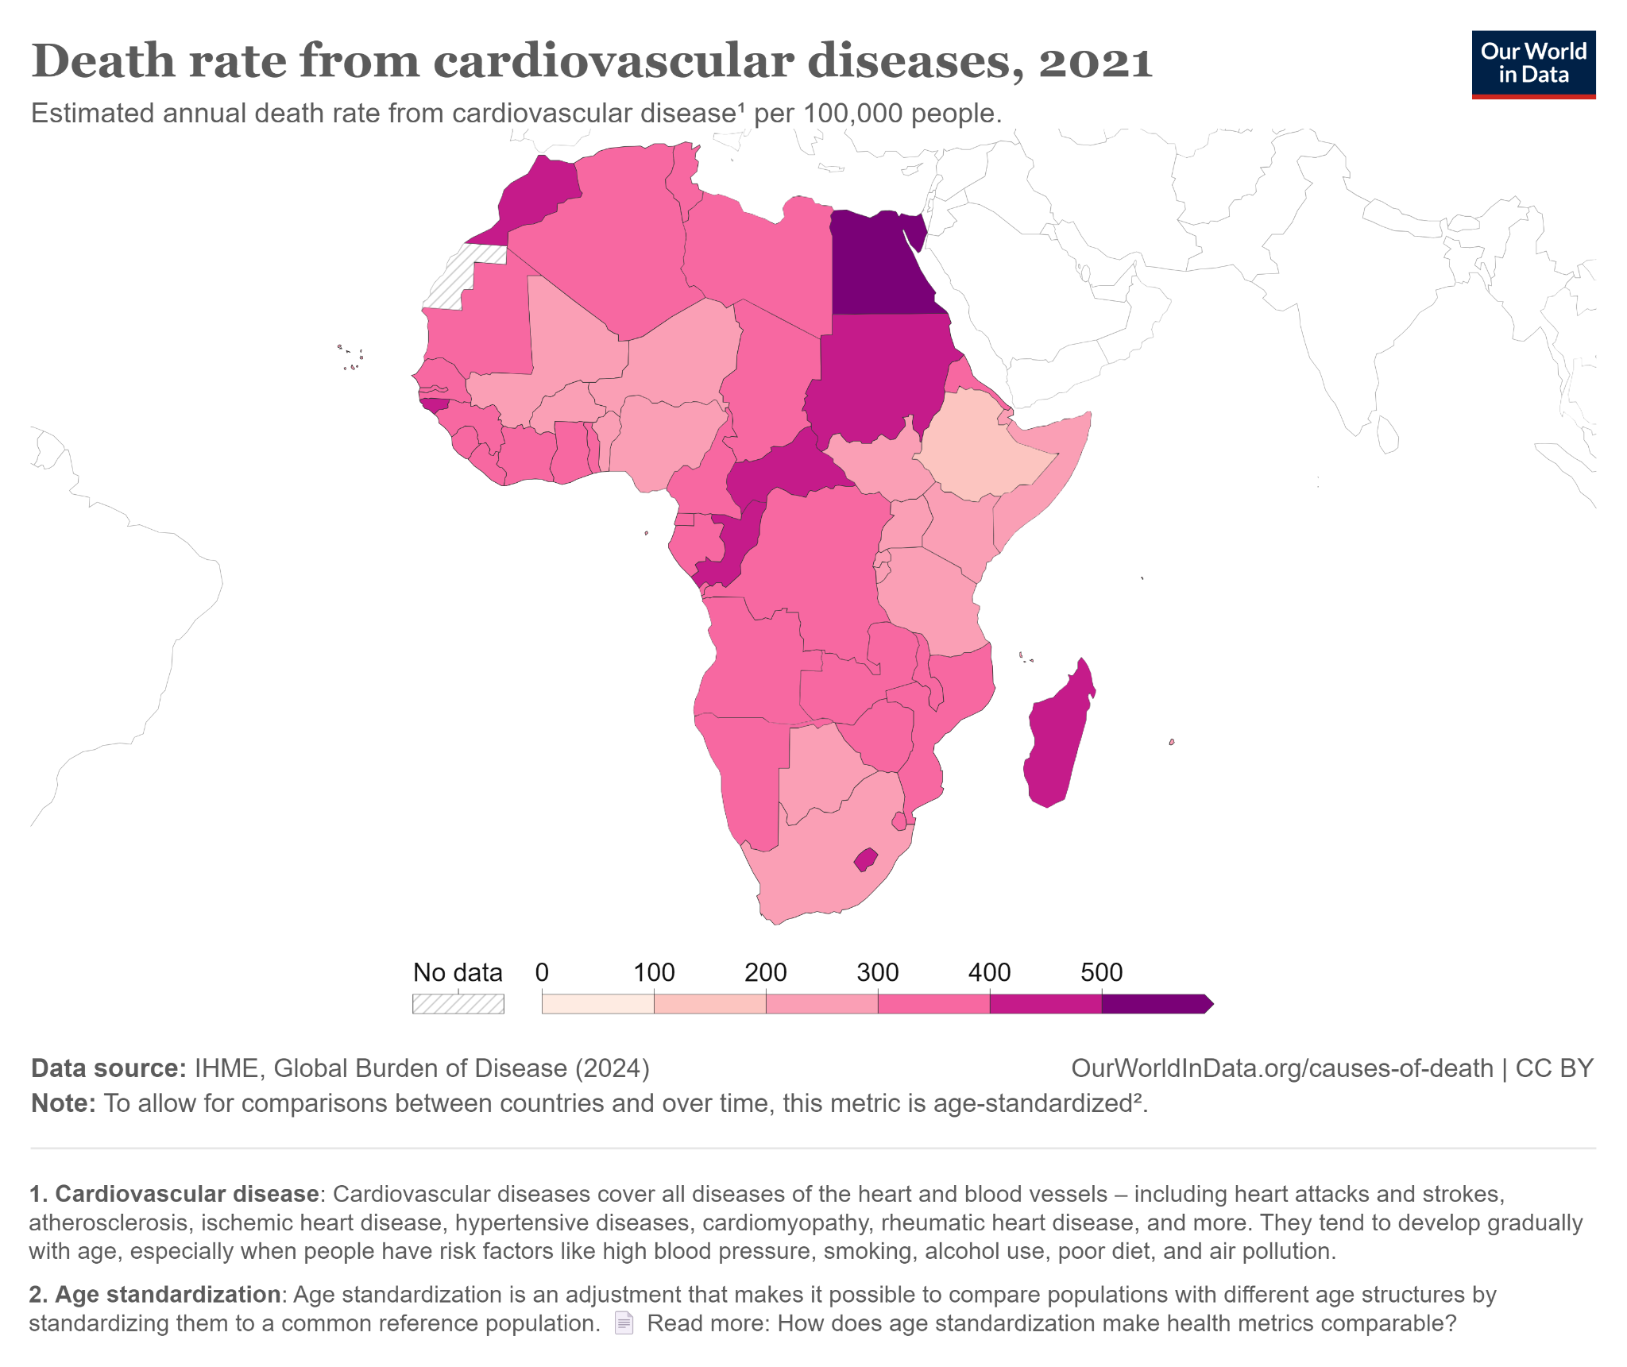
Problem Statement
Non-communicable diseases (NCDs) such as cardiovascular diseases, cancer, diabetes and chronic respiratory diseases are becoming leading causes of death. Additionally, mental health issues like depression and anxiety are prevalent but often underdiagnosed and untreated.
Data Illustration
WHO Illustration
Problem: Lack of Early Detection and Prevention: -Unaware of their risk factors for NCDs and mental health conditions, leading to late diagnosis and treatment.
Significance - Heath Impact[
Premature Deaths
Mental Health Crisis
]
- Economic Burden[
Healthcare Costs
Lost Productivity
]
High mortality rates from non-communicable diseases and widespread mental health issues are significantly reducing life expectancy and quality of life in Africa.
Notes:
Economic Burden:
Healthcare Costs: Families face substantial financial strain due to the high cost of medical treatments and long-term care for NCDs and mental health conditions.
Lost Productivity: Illness and premature death reduce workforce productivity, impacting economic growth and development.
Healthcare System Strain: The high demand for treating NCDs and mental health issues overwhelms healthcare systems, leading to reduced quality of care and increased healthcare costs.

Slide 3

Solution
Product Overview: Salama AI is a web-based health platform designed to address the high mortality rates from non-communicable diseases (NCDs) and improve mental health outcomes in Africa. The web application offers a comprehensive suite of AI-driven tools and services to make healthcare accessible, affordable, and effective.
3. Secure Data Sharing:
Shares sensitive user data securely using encryption features, protecting user information while facilitating necessary data access.
How it’s addressing:
1. AI-Powered Risk Assessment
Salama AI joins the fight in reducing mortality from non-communicable diseases and improves mental health by offering tools for tracking health metrics, AI-powered risk assessments, image analysis for unhealthy habits, virtual coaching, medication reminders, and streamlined consultations.
Uses AI to identify high-risk individuals for NCDs, enabling early intervention.
3.Medication Reminders:
2. Virtual Coaching and Therapy:
Sends reminders to ensure users take their medications as prescribed.
Provides guidance and virtual therapy to support health management and mental well-being.
SalamaAI
Notes:
How it’s addressing the issue
by offering tools for tracking health metrics, AI-powered risk assessments, image analysis for unhealthy habits, virtual coaching, medication reminders, and streamlined consultations.
Unique features
1. AI-Powered Risk Assessment
2. Virtual Coaching and Therapy:
3.Image Analysis for Health Insights:
3.Medication Reminders:

Slide 4
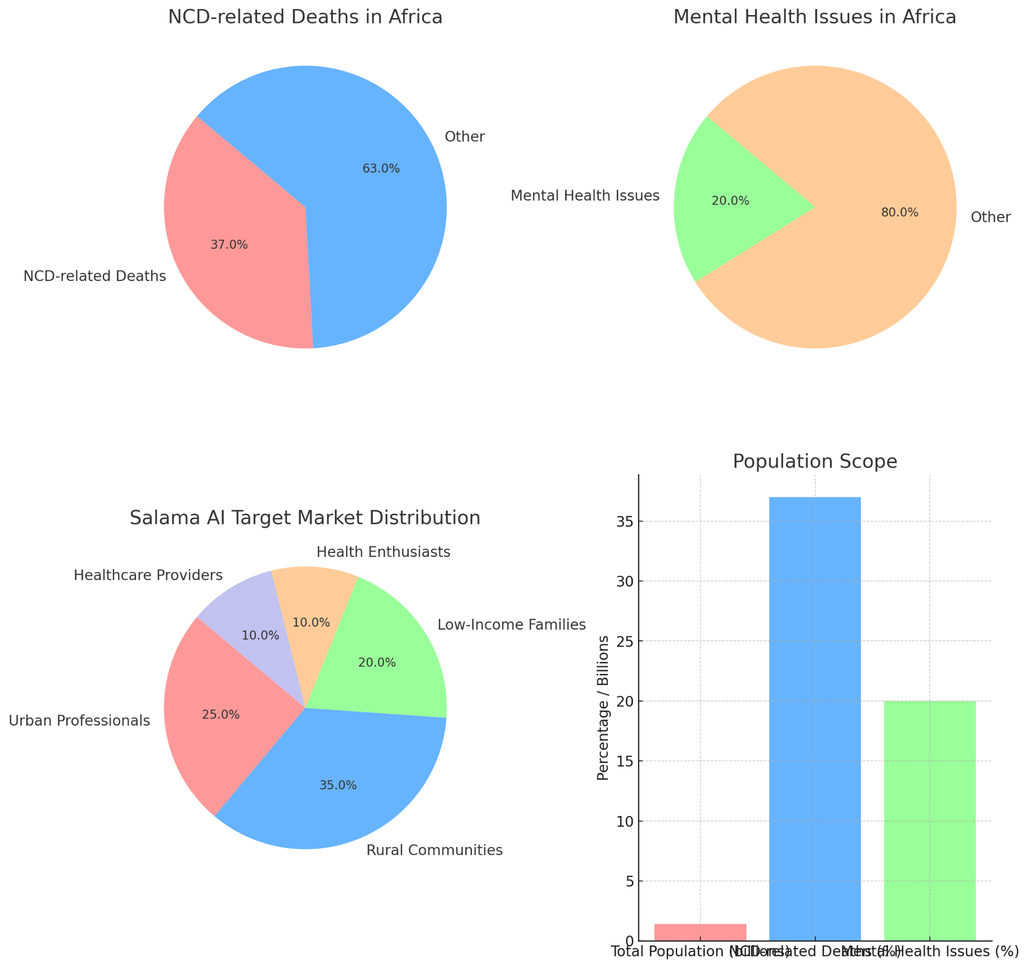
Market Opportunity
Definition:
The target market for Salama AI comprises individuals and communities in Africa who are at risk of or currently suffering from non-communicable diseases (NCDs) and mental health issues. This includes:
1. Market Trends:
- Rising Prevalence of NCDs:
- Digital Health Expansion:
- Mental Health Awareness
1.Individuals Experiencing Mental Health Issues
-People suffering from conditions such as depression, anxiety, and other mental health disorders.
-Those seeking accessible mental health support and therapy.
2. Adults with Risk Factors for NCDs
-Individuals with lifestyle-related risk factors such as poor diet, lack of physical activity, and high stress levels.
-People with a family history of NCDs like cardiovascular diseases, diabetes, and cancer.
2. Growth Potential
-Economic Factors
-Government and Institutional Support
Customer Segment
Priority
3. Rural and Underserved Communities:
-Individuals with lifestyle-related risk factors such as poor diet, lack of physical activity, and high stress levels.
-People with a family history of NCDs like cardiovascular diseases, diabetes, and cancer.
1.Health Providers
Medium
2.Health Enthusiast
Low
3.Rural Communities
High
4.Low-Income Families
High
5.Urban Professionals
Medium
SalamaAI
Notes:
NCD-related Deaths in Africa:
37% of deaths in Africa are due to non-communicable diseases (NCDs).
Mental Health Issues in Africa:
20% of the population is affected by mental health issues.
Economic Segments
Salama AI Target Market Distribution:
Urban Professionals: 25%
Rural Communities: 35%
Low-Income Families: 20%
Health Enthusiasts: 10%
Healthcare Providers: 10%
Combined Overview
Population Scope Bar Chart:
Total Population (billions): 1.4
NCD-related Deaths: 37%
Mental Health Issues: 20%

Slide 5
Business Model - Revenue Streams & Pricing Strategy
1. Product Sales:
- Revenue is generated from selling the product directly to customers.
Strategies
Cost-Plus Pricing:
The price is set by adding a fixed amount to the cost of producing the product.
2.Subscription Fees:
Customers pay a recurring fee (monthly or yearly) to access the product or service.
3.Transaction Fee:
A fee is earned from each transaction processed through the platform
E.g
If the production cost is $10 and a $5 profit is added, the selling price is $15.

Slide 6
Marketing & Sales Strategy
Marketing channels: 1. Social Media 2.Content Marketing 3.Email Marketing 4.Search Engine Optimization (SEO)
Retaining Customers 1.Customer Support
2.Customer Feedback
3.Loyalty Programs
SalamaAI
Notes:
1. Social Media : eg. X, LinkedIn ,to reach potential customers through targeted ads, engaging content, and promotions.
2.Content Marketing: blogs, videos, and infographics that address customer pain points and showcase the benefits of the product.
Email Marketing: Use email campaigns to inform potential and existing customers about new features, promotions, and updates.
Retaining Customers:
Customer Support:
24/7 Support: Provide reliable customer support to address issues and answer questions promptly.
Knowledge Base: Create a comprehensive knowledge base or FAQ section to help customers find answers on their own.
Customer Feedback:
Surveys and Reviews: Regularly collect feedback to understand customer satisfaction and areas for improvement.
Feature Updates: Use feedback to guide product improvements and updates, ensuring the product continues to meet customer needs.

Slide 7


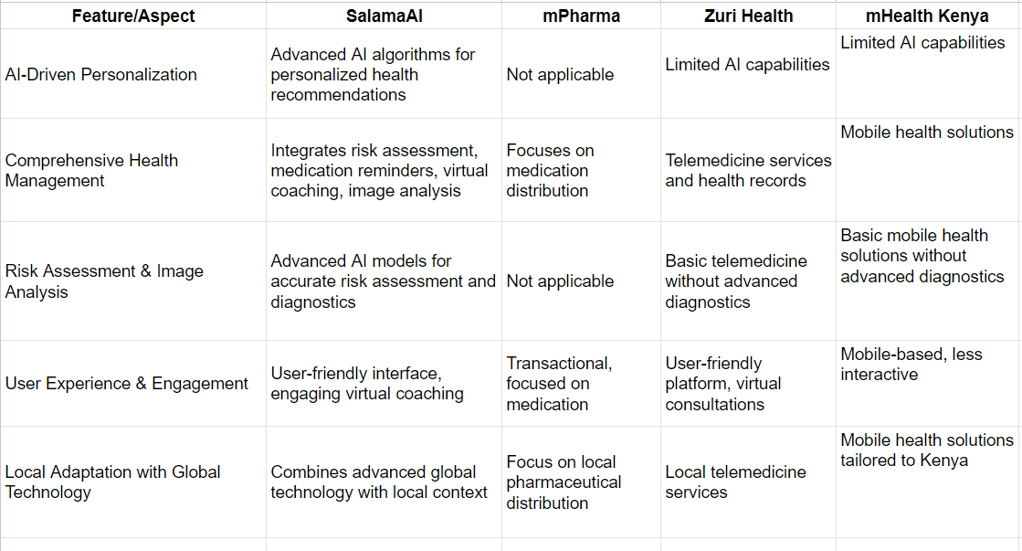

Competitive Landscape
Mobile Health Solutions – mHealth Kenya focuses on mobile-based health solutions, making healthcare services accessible to users with limited internet access.
Wide Reach – mPharma has an extensive distribution network across several African countries, making medications widely accessible.
Comprehensive Telemedicine – Zuri Health offers a broad range of telemedicine services, including virtual consultations, enhancing healthcare accessibility.

Slide 8

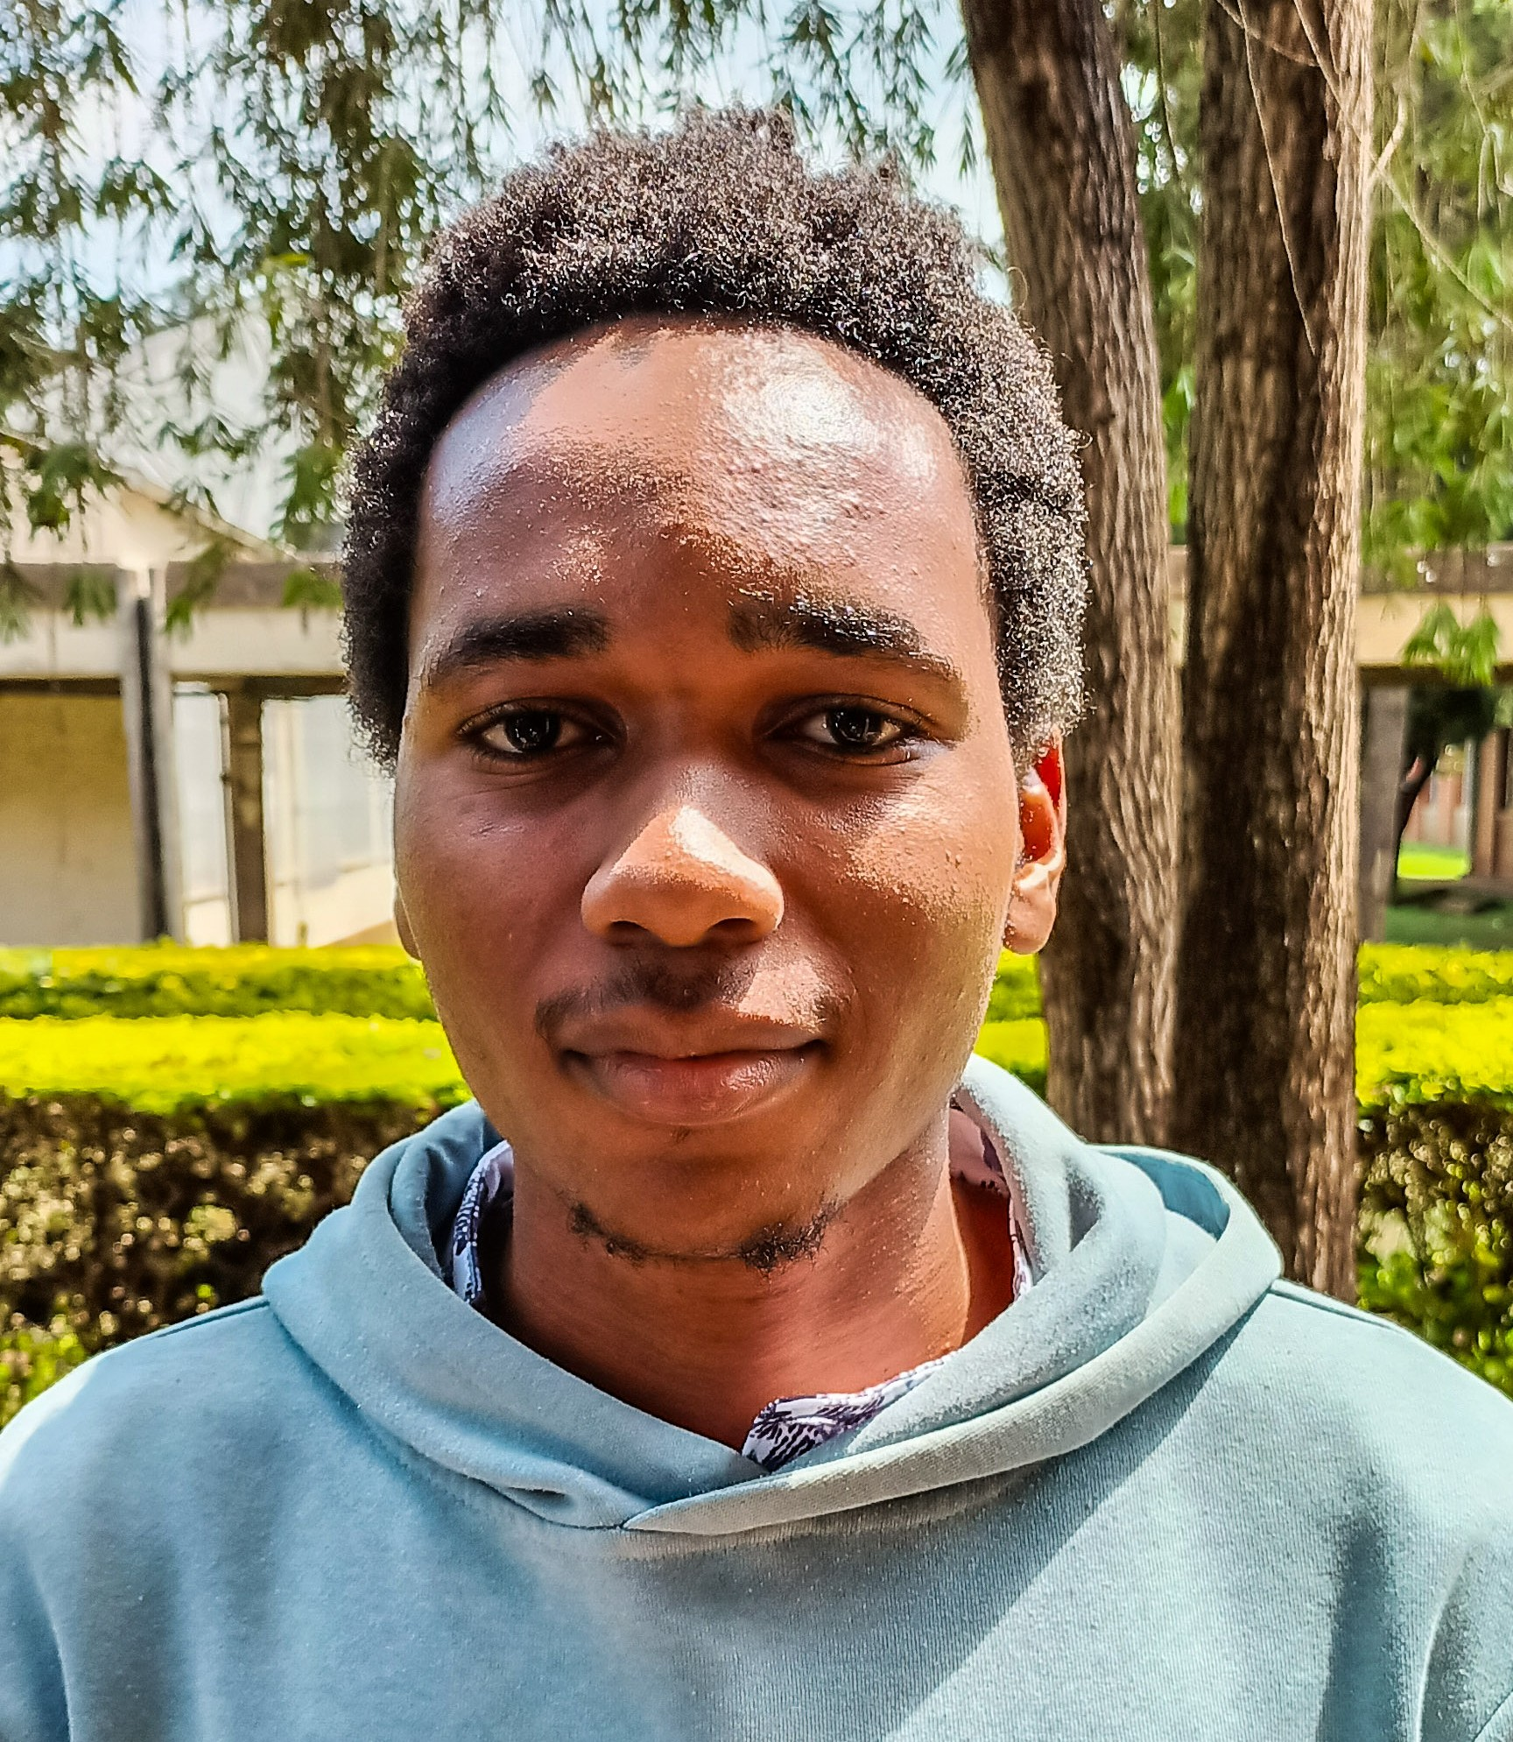

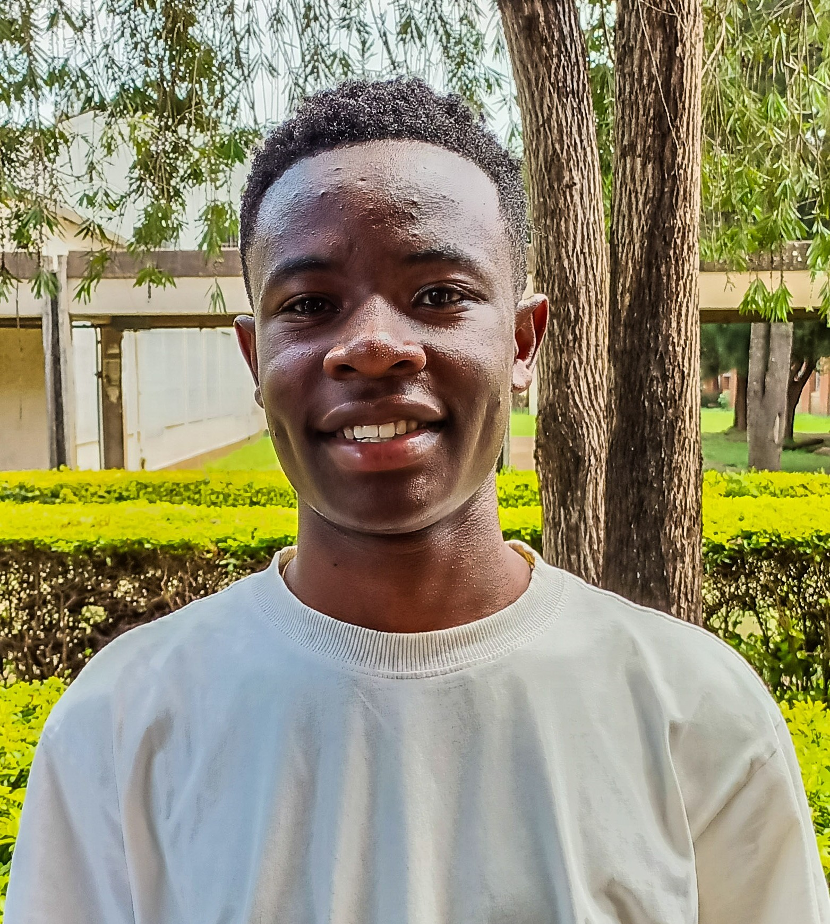
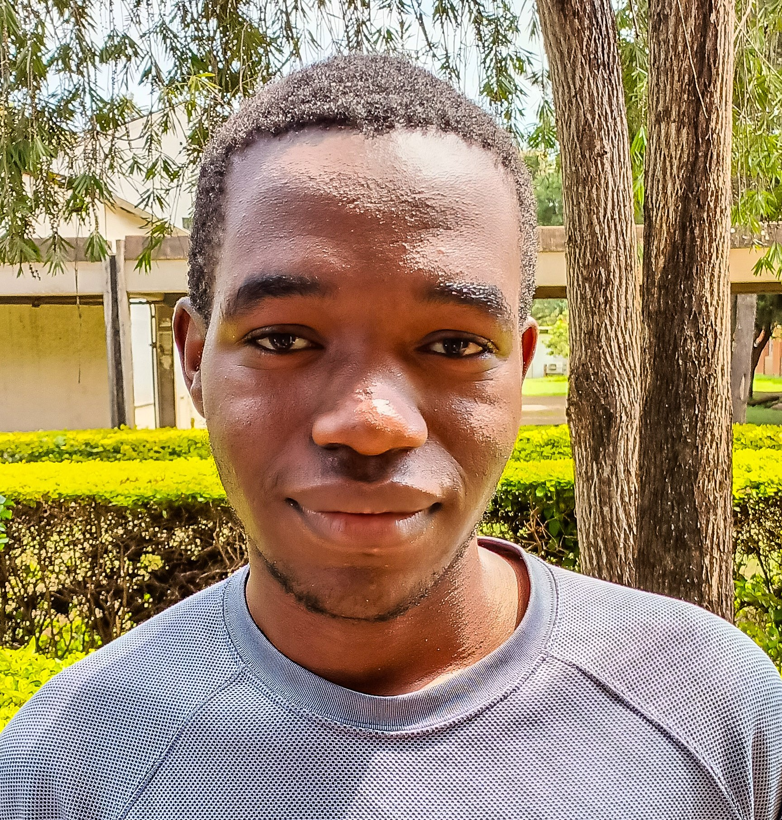
Team
c
Nathan Sikalo UI/UX Designer
Njuki Nestor Mugambi Backend Developer
Boniface Wagoya Frontend Designer
Antony Njuguna
Backend Developer
Julius Mwangi
Database Developer

Slide 9
Call to Action
SalamaAI is seeking mentorship to support its growth and development
Contact Information
Request: Experienced guidance from industry experts, seasoned entrepreneurs, and business leaders.
Purpose: To gain strategic insights, overcome challenges, and refine business strategies to achieve sustainable growth and impact in the healthcare sector.
Email: arieinestor14@gmail.com
Phone Number: +254746607092
SalamaAI

Slide 10
Q&A
SalamaAI

